Slide 1
Lecture 6
DTMC – Occupancy Times and Occupancy Times Matrix

Slide 2
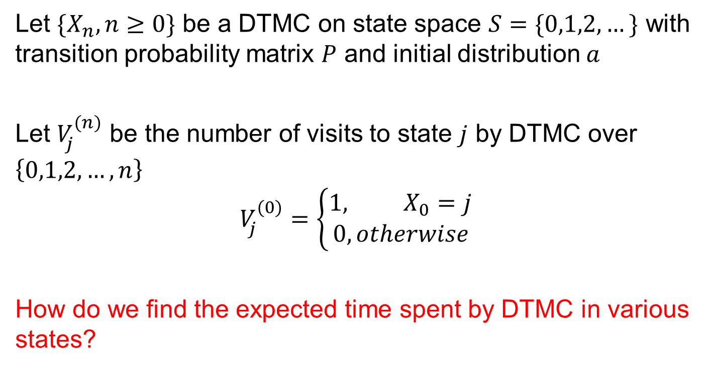
Occupancy Times
Let $\{X_{n},n≥0\}$ be a DTMC on state space $S=\{0,1,2,…\}$ with transition probability matrix $P$ and initial distribution $a$
Let $V_{j}^{(n)}$ be the number of visits to state $j$ by DTMC over $\left\{0,1,2,…, n\right\}$
$$V_{j}^{(0)}=\left\{\begin{aligned}1, X_{0}=j \\ 0, otherwise\end{aligned}\right.$$
How do we find the expected time spent by DTMC in various states?

Slide 3
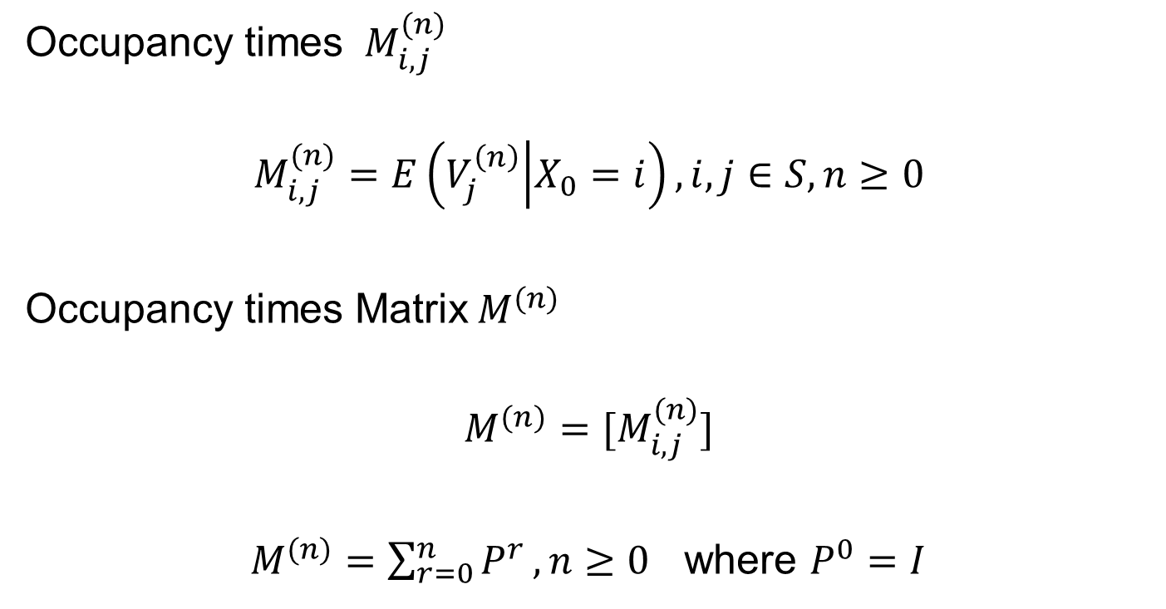
Occupancy Times and Matrix
Occupancy times ${ M}_{i,j}^{(n)}$
$$M_{i,j}^{(n)}=E\left(V_{j}^{\left(n\right)} | X_{0}=i\right), i,j∈S, n≥0$$
Occupancy times Matrix${ M}^{(n)}$
$${M^{(n)}=[M}_{i,j}^{(n)}]$$
$M^{(n)}=\sum_{r=0}^{n}{P^{r}}, n≥0$ where $P^{0}=I$

Slide 4
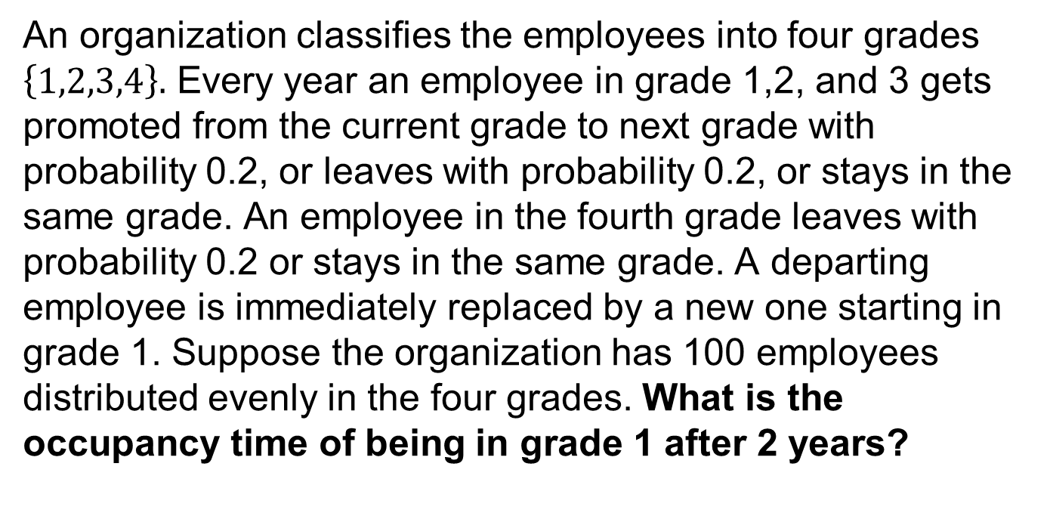
Example 2.23 (Kulkarni 3rd ed) Revisited
An organization classifies the employees into four grades $\left\{1,2,3,4\right\}.$ Every year an employee in grade 1,2, and 3 gets promoted from the current grade to next grade with probability 0.2, or leaves with probability 0.2, or stays in the same grade. An employee in the fourth grade leaves with probability 0.2 or stays in the same grade. A departing employee is immediately replaced by a new one starting in grade 1. Suppose the organization has 100 employees distributed evenly in the four grades. What is the occupancy time of being in grade 1 after 2 years?

Slide 5

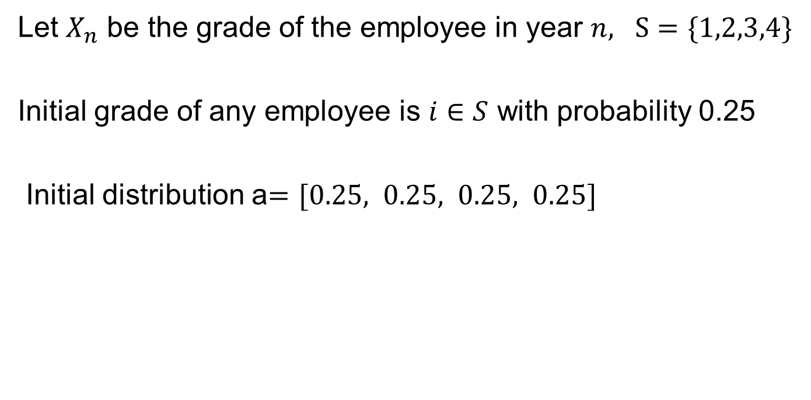
Example 2.23 – Solution Hint
Let $X_{n}$ be the grade of the employee in year $n, S=\{1,2,3,4\}$
Initial grade of any employee is $i∈S$ with probability 0.25
Initial distribution a$=[0.25, 0.25, 0.25, 0.25]$
0.8 0.2 0.0 0.0
0.2 0.6 0.2 0.0
0.2 0.0 0.6 0.2
0.2 0.0 0.0 0.8
$$P=$$

Slide 6
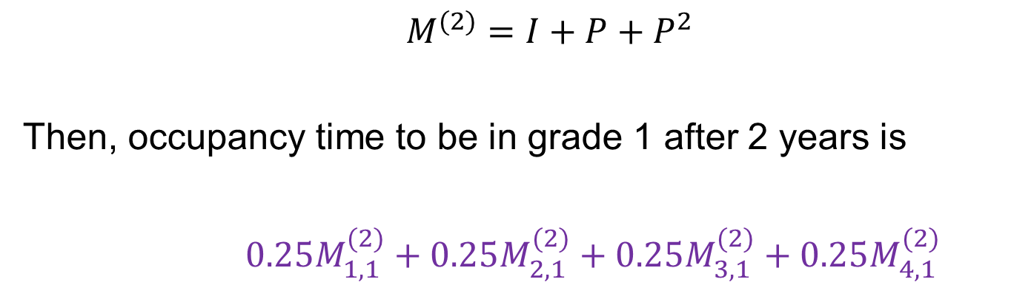

Example 2.23 – Solution Hint
There is equal probability to start from any state $i,i∈S$
We know that
$$M^{(2)}=I+P+P^{2}$$
Then, occupancy time to be in grade 1 after 2 years is
$0.25M_{1,1}^{(2)}+0.25M_{2,1}^{(2)}+0.25M_{3,1}^{(2)}+0.25M_{4,1}^{(2)}$

